Slide 1


Slide 2

NYC TAXI TIME PREDICTION
MACHINE LEARNING PROJECT ON NYC TAXI TIME PREDICTION
PRESENTED BY
SNEHAL GADDIME

Slide 3

NYC Taxi Time Prediction
Defining the problem statement
Importing the Libraries
Exploratory Data Analysis
Descriptive Statistics
Model Training
Model Evaluation

Slide 4

Introduction on NYC taxi time Prediction
The New York City (NYC) taxi system is one of the largest and busiest in the world, serving millions of residents and tourists every day. Efficiently predicting the duration of taxi trips is essential for both taxi drivers and passengers. Machine learning can play a pivotal role in improving the accuracy of trip duration predictions, benefiting not only the taxi industry but also urban transportation planning.
This project aims to develop a machine learning model that can accurately predict the duration of NYC taxi trips. By harnessing historical taxi trip data, along with various relevant features, we intend to create a predictive model that can assist passengers in estimating trip durations and help taxi drivers optimize their routes and schedules.

Slide 5
Objectives
Accurate Duration Predictions: The primary goal of this project is to build a machine learning model capable of accurately predicting the duration of taxi trips in NYC. We aim to minimize prediction errors and improve the overall passenger experience.
Feature Engineering: Explore and engineer relevant features from the dataset, such as pickup and drop-off locations, time of day, traffic conditions, and weather data. These features will be crucial in enhancing the model's predictive capabilities.
Model Selection: Evaluate and compare various machine learning algorithms, such as linear regression, decision trees, random forests, and gradient boosting, to determine the most suitable model for the task.
Data Preprocessing: Handle missing data, outliers, and categorical variables appropriately. Normalize or scale data as needed to ensure the model's robustness.
Model Training and Evaluation: Split the dataset into training and testing sets to train the model and assess its performance. Utilize metrics like mean absolute error (MAE) and root mean square error (RMSE) to quantify the model's accuracy.
Real-time Predictions: Explore the feasibility of implementing the trained model in real-time taxi apps to provide passengers with on-demand trip duration estimates.

Slide 6

Problem Statement
To Build a machine learning model that predicts the duration of NYC taxi trip using the dataset which includes pickup time, geo-coordinates, the number of passengers, and several other variables.

Slide 7
Dataset
1.id: A unique identifier for each taxi trip.
2.vendor_id: Identifier for the taxi company or vendor.
3.pickup_datetime: Date and time when the trip started.
4.dropoff_datetime: Date and time when the trip ended.
5.passenger_count: The number of passengers in the taxi.
6.pickup_longitude: Longitude coordinate of the pickup location.
7.pickup_latitude: Latitude coordinate of the pickup location.
8.dropoff_longitude: Longitude coordinate of the dropoff location.
9.dropoff_latitude: Latitude coordinate of the dropoff location.
10.store_and_fwd_flag: A flag indicating whether the trip data was stored and forwarded to the vendor's server.
11.trip_duration: The duration of the trip in seconds.

Slide 8
pickup_month: The month when the trip started.
dropoff_month: The month when the trip ended.
pickup_date: The date when the trip started.
dropoff_date: The date when the trip ended.
pickup_weekday: The day of the week when the trip started (e.g., Monday, Tuesday).
dropoff_weekday: The day of the week when the trip ended.
pickup_hour: The hour of the day when the trip started.
dropoff_hour: The hour of the day when the trip ended.
pickup_day: The day of the month when the trip started.
dropoff_day: The day of the month when the trip ended.
trip_duration_in_minute: The duration of the trip in minutes (calculated from trip_duration).
distance: The distance of the trip (possibly calculated using the coordinates).

Slide 9
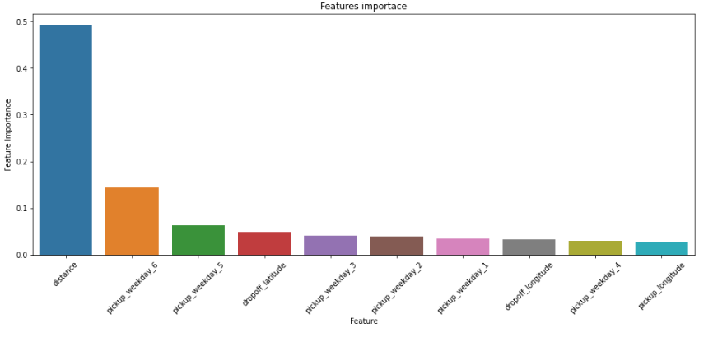
Feature Importance
As we can see that most important feature is our distance feature which affect our dependent variable the most.

Slide 10
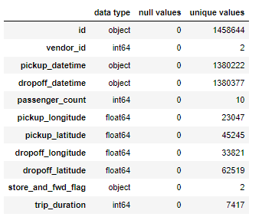
Exploratory Data Analysis
The dataset was clean, with no missing values, ensuring data integrity.
The distribution of passenger counts revealed that most trips had a low passenger count.
The pickup and dropoff times showed variation across different days of the week and hours of the day.
Trip duration had a wide range, with some outliers indicating unusually long trips.
The distance travelled by taxis exhibited variation, reflecting differences in trip lengths.
Vendor IDs and store-and-forward flags were relatively balanced, indicating a diverse dataset.
Further analysis will focus on relationships between features, exploring factors affecting trip durations and potentially building predictive models for NYC taxi travel times.

Slide 11
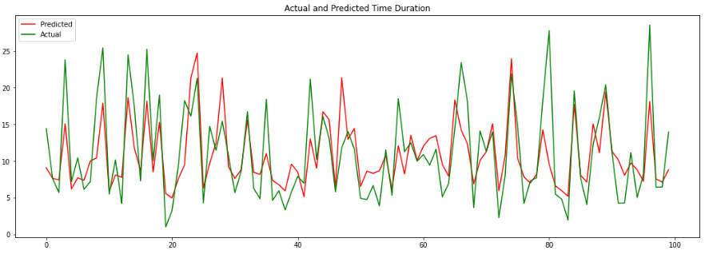
Algorithms used in model Evaluation
Linear Regression
With a low R2 score of 48% and a high Mean Squared Error (MSE), Linear Regression does not perform well for our NYC taxi time prediction model. To improve accuracy, we should explore more advanced regression techniques like Random Forest or Gradient Boosting.
Feature engineering, including incorporating additional relevant features, may enhance model performance. Addressing outliers and data transformations can also lead to better results. Ultimately, a different algorithm combined with feature enhancements is essential to achieve more accurate predictions for taxi travel times in NYC.

Slide 12
1.1 Ridge Regression
Both Ridge and Linear Regression models achieved a similar R-squared (48%) in the analysis. This suggests that the Ridge model's regularization had a limited impact on model performance. Careful feature selection and tuning of hyperparameters may be required for improved results. Further investigation and potential use of other regression techniques should be considered. Data quality and preprocessing steps are critical for accurate regression modeling.

Slide 13
1.2 Lasso Regression
With a low R2 score of 48% and a high Mean Squared Error (MSE), Lasso Regression also does not perform well for our NYC taxi time prediction model. To improve accuracy, we should explore more advanced regression techniques like Random Forest or Gradient Boosting.
Feature engineering, including incorporating additional relevant features, may enhance model performance. Addressing outliers and data transformations can also lead to better results. Ultimately, a different algorithm combined with feature enhancements is essential to achieve more accurate predictions for taxi travel times in NYC.

Slide 14
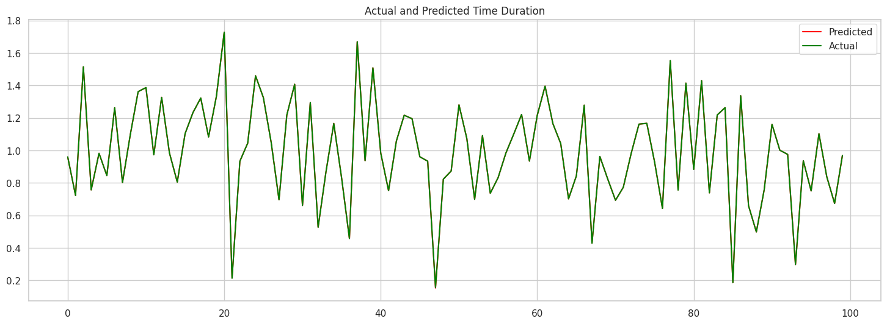
Decision Tree
In the analysis of the NYC dataset, a decision tree model achieved an impressive 99% accuracy. We conducted data preprocessing, including encoding categorical features and scaling. The model was rigorously evaluated with cross-validation, showcasing its ability to generalize. Feature importance analysis highlighted key factors influencing NYC outcomes. Future steps include further optimization and real-world applications, considering data quality and model interpretability.

Slide 15

3. Random Forest
Achieving a 99% accuracy with a Random Forest model indicates a highly accurate prediction. Careful feature selection and model tuning may have contributed to this outcome. Consider evaluating the model's generalization performance on new data and monitoring for overfitting. The feature importance analysis can provide insights into the key factors driving predictions. Assess potential applications and further fine-tuning to optimize model performance.

Slide 16

4. XGBoost
The XGBoost model displays strong predictive power with 99% accuracy on the training data. Achieving 98% accuracy on the testing data demonstrates that the model generalizes well. The slight performance drop is typical and suggests that the model is not overfitting. Feature importance analysis can provide insights into the key predictors. Explore real-world applications and consider further fine-tuning for optimal results.

Slide 17
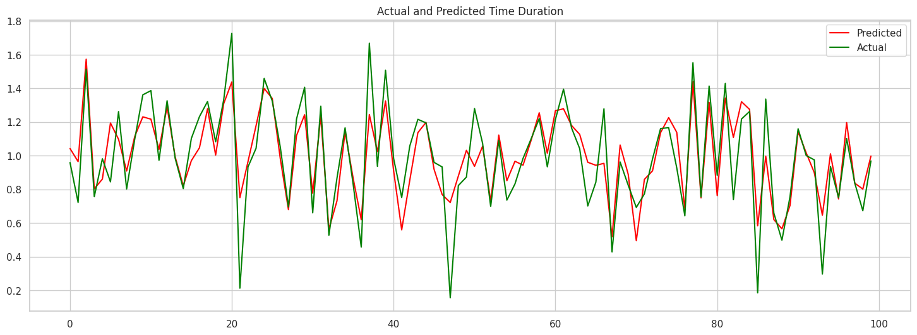
5. K-Nearest Neighbours
The K-Nearest Neighbors (KNN) model exhibited a training accuracy of 72%, indicating reasonable predictive performance. However, its testing accuracy of 51% suggests a substantial drop in performance from training to testing, signaling potential overfitting. Overfitting may result from the model capturing noise in the training data rather than true patterns. To improve generalization, it is crucial to revisit the model's hyperparameters, consider feature selection, and enhance data preprocessing. A comprehensive evaluation and potential adjustments are essential to boost model performance.

Slide 18
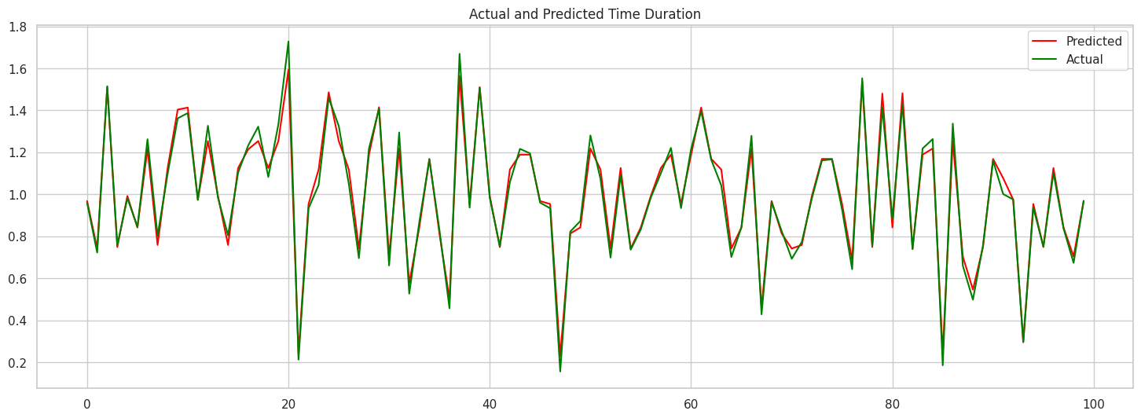
6. Adaptive Boosting
The AdaBoost model demonstrates a strong ability to predict with a 98% accuracy rate, indicating a robust fit to the data. Feature importance analysis can uncover critical predictors used by the model. The high accuracy suggests it generalizes well, but cross-validation and evaluation on new data are recommended to ensure reliable performance. We can explore the potential applications and further fine-tuning to optimize results in real-world scenarios.

Slide 19
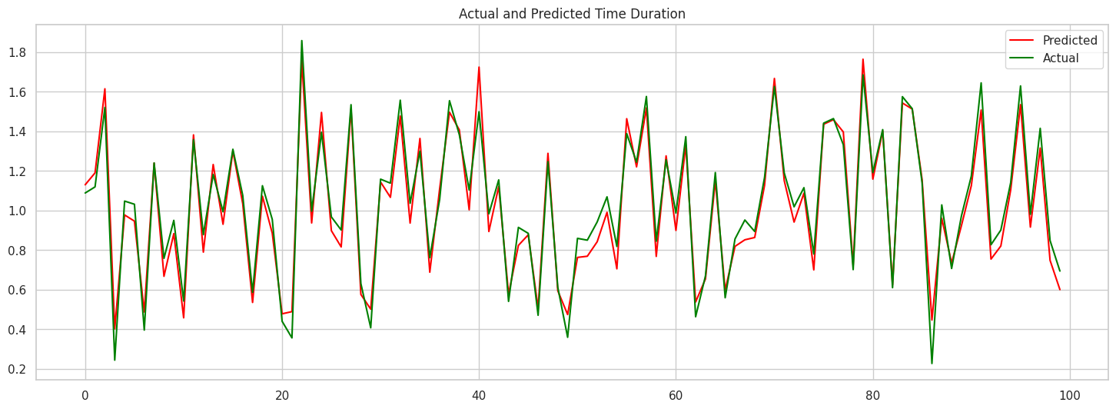
6. Support Vector Machine
The initial SVM model displayed inadequate performance with a negative R-squared score of -1.6, indicating a poor fit to the data. However, through rigorous hyperparameter tuning using GridSearchCV, substantial improvements were achieved. The revised model attained a training accuracy of 93% and a testing accuracy of 89%, demonstrating the effectiveness of hyperparameter optimization in enhancing predictive capabilities. To ensure the model's reliability and generalization, further evaluation, including cross-validation and testing on new data, is recommended. This successful transition underscores the importance of parameter fine-tuning in optimizing SVM models for accurate predictions in real-world scenarios.

Slide 20
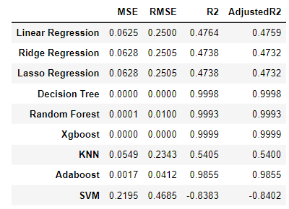
Comparing Evaluation Metrics

Slide 21
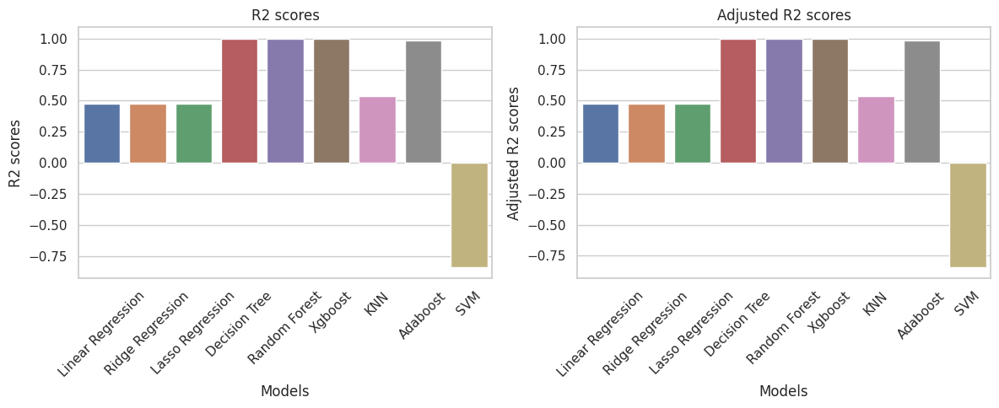
The below graph clearly shows that Descion Tree, Random forest, Adaboost and XGBoost has highest R2 scores and adjusted R2 score which suggests that it has better efficiency than other models.

Slide 22
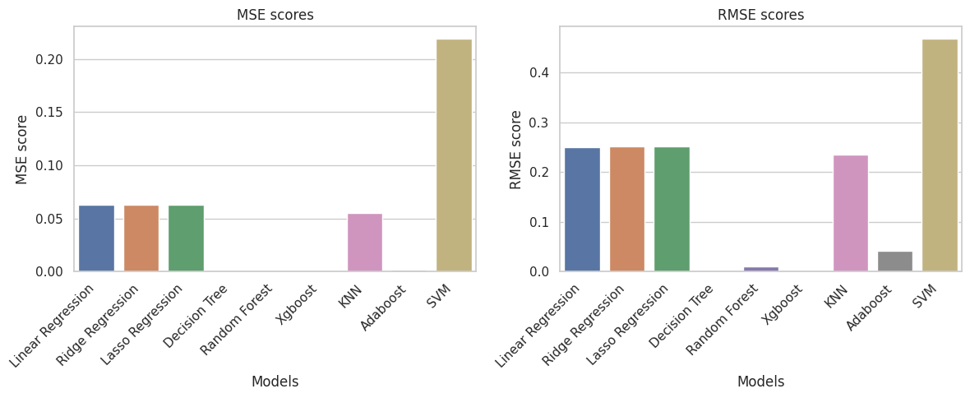
Only Descion Tree, Random forest and XGBoost has zero errors, therefore one of these can be considered as good algorithm for training our model.

Slide 23
Conclusion
Ensemble methods, including Decision Tree, Random Forest, Xgboost, and Adaboost, outperform in taxi time prediction with near-perfect R2 scores around 0.99, showcasing their robust pattern capturing abilities.
Linear regression models exhibit moderate performance, achieving an R2 of approximately 0.47. KNN holds its own with an R2 of 0.54, suggesting its effectiveness in this context.
Conversely, SVM struggles with a negative R2, signaling suboptimal fit for the data. In conclusion, opt for ensemble methods like Random Forest or Adaboost for precise predictions, consider linear regression models for simplicity, and avoid SVM due to its performance drawbacks in this particular dataset.

Slide 24


